Slide 1
EmpowHer
EmpowHER: Empowering Girls for Corporate Excellence
The Role of the Production Support Team

Slide 2
Agenda
Introduction
What is Production Support?
Role of the Production Support Team
Key Responsibilities of the Production Support Team
Incident Management
Problem Management
Change Management
Release and Deployment Management
Skills Required in the Production Support Team
Conclusion

Slide 3
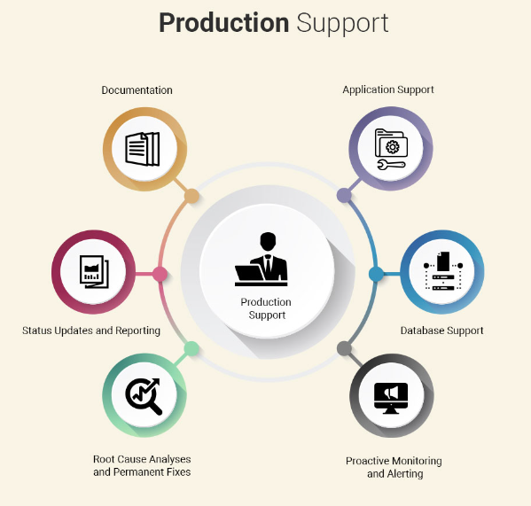
Introduction
Production support covers the practices and disciplines of supporting the IT systems/applications which are currently being used by the end users.

Slide 4

What is Production Support?
Production support as the name says is about Supporting the production environment of the company.
Production support involves working closely with business stakeholders (such as traders) to resolve any issues with technical systems and applications.
In a trading environment, traders will typically raise 'tickets' – requests for help – with the support teams, usually over e-mail or by telephone. Those tickets will enter a queue of work where the progress of investigations can be tracked.
The Production Support team pick up those tickets and work to address the issues, liaising with other technical teams where necessary.

Slide 5
Role of the Production Support Team
Monitoring: He/She would have to monitor the system very closely and can not afford to leave the system without someone else monitoring it. It is a 24*7 job defined within a team to work in shifts.
On Call Support: As it is as 24*7 responsibility. In case if some issue occurs after working hours then He/she would have to be available to resolve the issue on priority.
P1, P2, P3 Priority Issues: Issues are raised based on the priorities. P1>P2>P3… P1 has very tight timeline to resolve the issue as It means the Business is down with this issue and it needs to be fixed at priority as It would be impacting business and would cause the monetary loss to the company.
Categorization of Issues: Report needs to be created to check what are the frequent issues we are getting and what is reason for that and If it can be resolved with some code changes so that such kind of issue do not originate in future.
SOP Document: SOP document needs to be created. This document lists the regular issues coming and steps needs to be taken to resolve such issues. SOP document then shared with the L1 Support team so that they can resolve the issue at their end by following the steps mentioned in the document.
Deployments: Support teams remain part of the deployments along with development team so that they will be familiar with changes that are getting deployed to the production as they would have to support the Application after it gets deployed to the Production.
L1, L2, L3 : Support is Categorized to L1, L2 and L3 Support.
L1: L1 team is the first point of contact when someone raises the issue. You can say Customer support team is the L1 Support whom the person contacts when he faces any issue in the product. They check information and get back to the Customer.
L2: If issue is not getting resolved by the L1 support then that issue gets passed to the L2 Support. L2 Support check configuration and other things which can help in resolving the issue.
L3: In case if L2 team also not able to resolve the issue and Issue might need some code changes then Issue gets transferred to the L3 Support team. L3 Support team is a technical team which works on the change requests and maintenance of the Application.

Slide 6
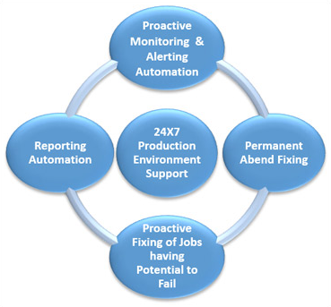
Key Responsibilities of the Production Support Team
Incident management
Problem management
Change management
Release and deployment management

Slide 7
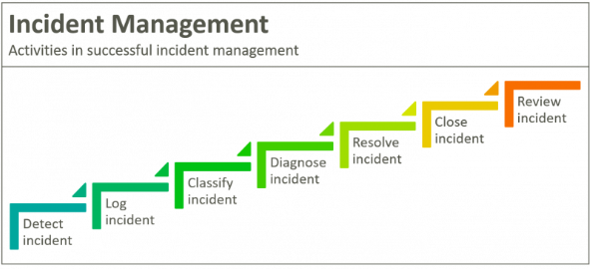
Incident Management
Incident management is the process of managing IT service disruptions and restoring services within agreed service level agreements (SLAs). The scope of incident management starts with an end user reporting an issue and ends with a service desk team member resolving that issue.
There are five steps in an incident management plan:
Incident identification.
Incident categorization.
Incident prioritization.
Incident response.
Incident closure.

Slide 8
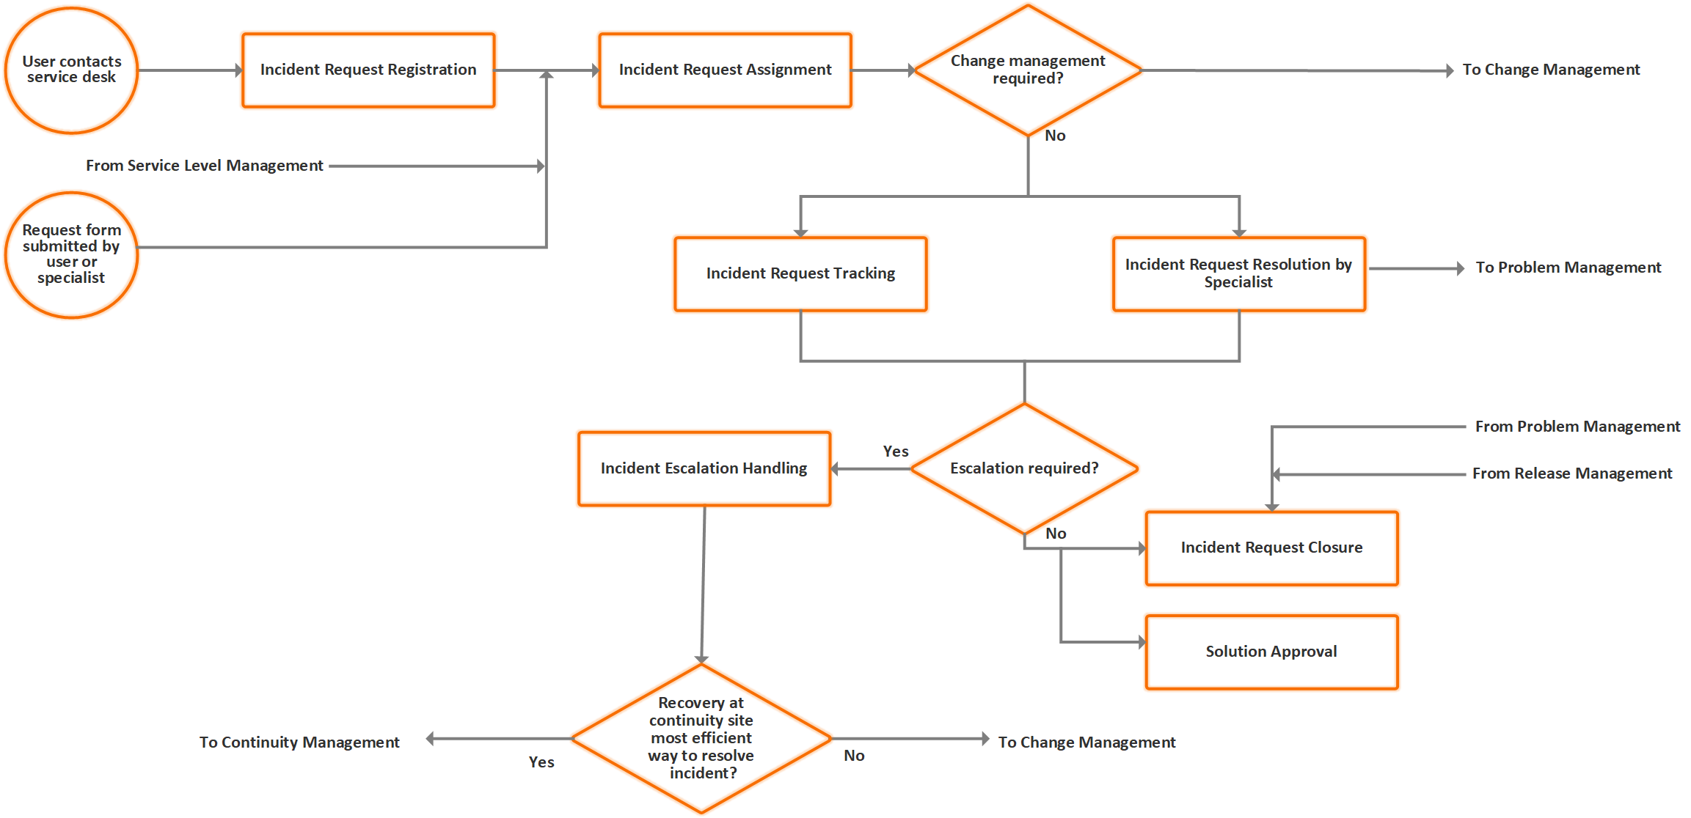
INCIDENT PROCESS:

Slide 9
COMMON IT INCIDENT MANAGEMENT ROLES:
End user / user / requester:
This is the stakeholder who usually experiences a disruption in service and raises an incident ticket to initiate the process of incident management.
Tier 1 service desk:
This is the first point of contact for the requesters when they want to raise a request or incident ticket. The Tier 1 service desk usually consists of technicians who have a working knowledge of the most common issues that might occur in an IT environment, including password resets and Wi-Fi problems.
Tier 2 service desk:
This service desk is made up of technicians with advanced knowledge of incident management. They usually receive more complex requests from end users; they also receive requests in the form of escalations from Tier 1.
Tier 3 (and above) service desk:
This level is usually comprised of specialist technicians who have advanced knowledge of particular domains in the IT infrastructure. For example, technicians for hardware maintenance and server support specialize in very specific fields.
Incident manager:
This stakeholder plays a key role in the process of incident management by monitoring how effective the process is, recommending improvements, and ensuring the process is followed, among other responsibilities.
Process owner:
This stakeholder owns the process followed for managing incidents. They also analyze, modify, and improve the process to ensure it best serves the interest of the organization.

Slide 10
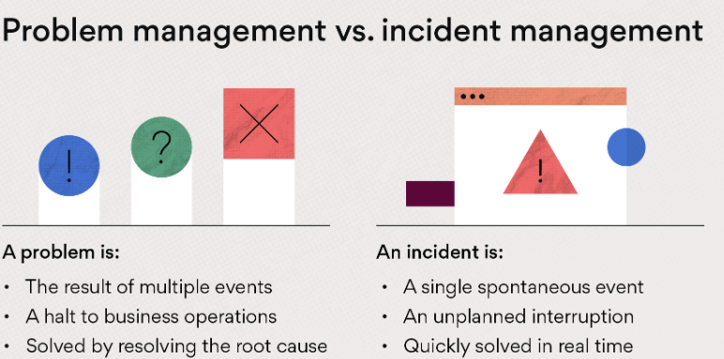
Problem Management
Problem management is the process of identifying and managing the causes of incidents on an IT service.
Problem management isn’t just about finding and fixing incidents but identifying and understanding the underlying causes of an incident as well as identifying the best method to eliminate that root cause.

Slide 11
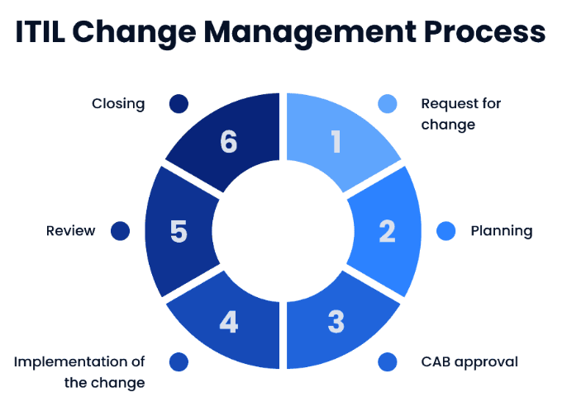
Change Management
Change management is the process of guiding organizational change from start to finish, including planning, implementing, and solidifying changes in an organization.
It refers to how companies handle modifications, such as the implementation of new technology, adjustments to existing processes, and shifting organizational hierarchy.
This process can look different based on the type of change you are conducting.

Slide 12
Skills Required in the Production Support Team
Try to be good in any Database with OS knowledge:
ex : ORACLE + UNIX/LINUX , .NET +windows
Get an idea about ITIL process:
( incident management, Problem management, Change Management) and LEAN processes ,SLA’s
Learn any ticketing tool:
ServiceNow
BMC remedy impact tool
HPSM
Learn any scheduling tool:
Control-M
Autosys
ESP
Get idea about monitoring tools
APM
SPLUNK
OPNET

Slide 13
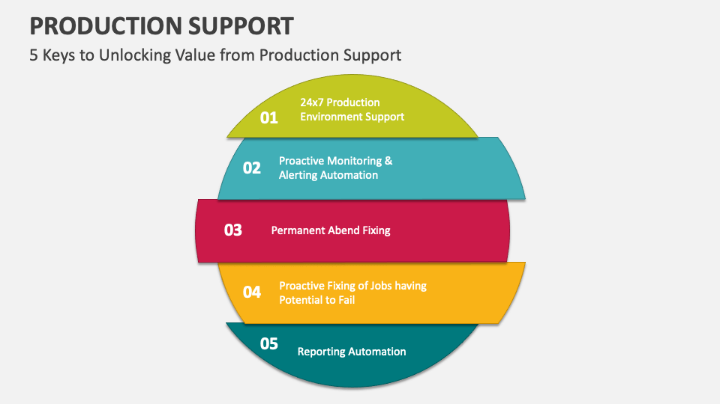
Conclusion

Slide 14

THANK YOU

Slide 15
Appendix
Add Links or permissible Images as needed

